Slide 1
Lesson 8 – Homework review

Slide 2




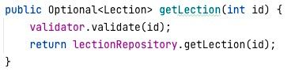
Use optional correctly

Slide 3
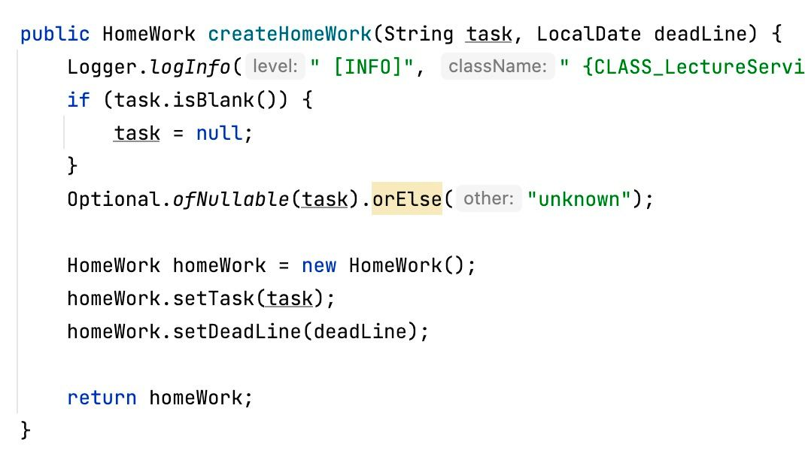
Use optional correctly

Slide 4
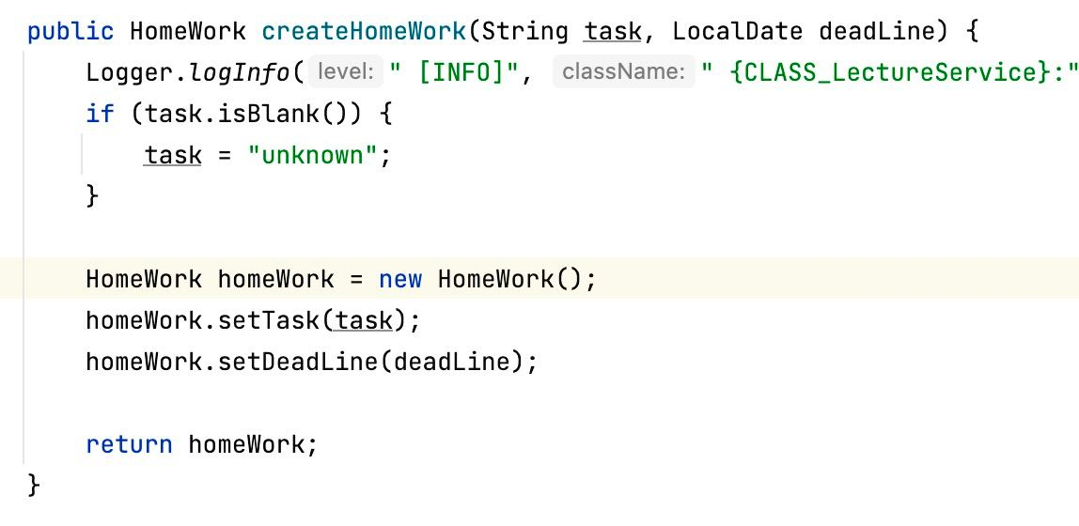
Use optional correctly

Slide 5
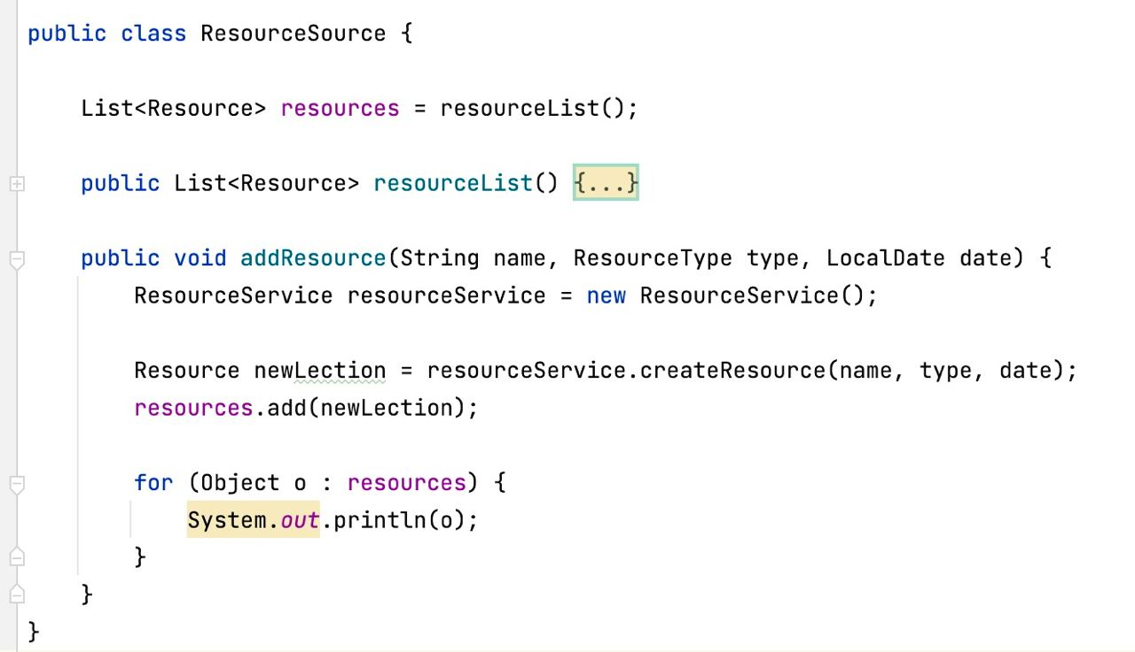
Follow layer structure

Slide 6
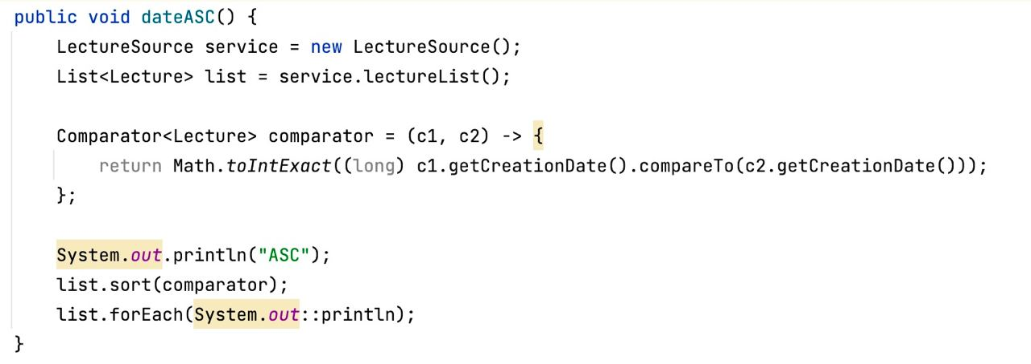
IDE is your friend

Slide 7
IDE is your friend

Slide 8
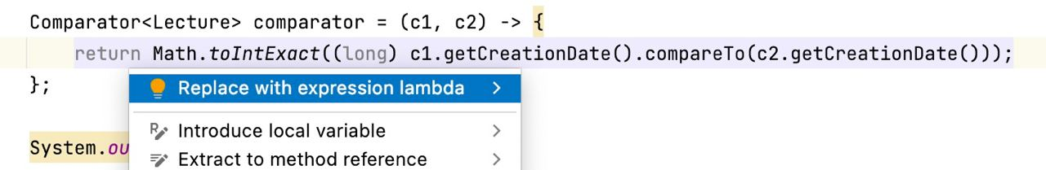
IDE is your friend

Slide 9
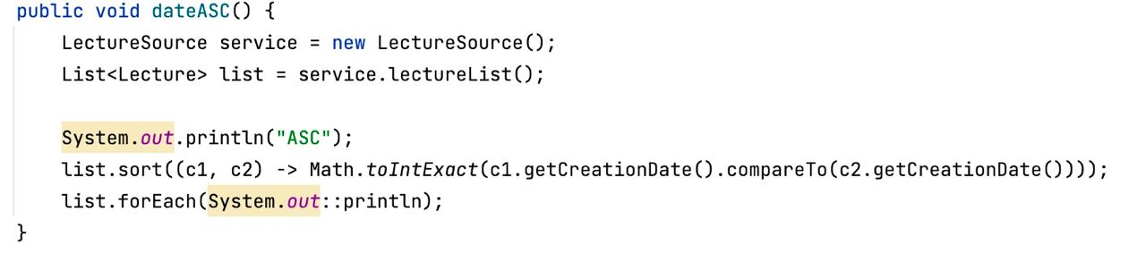
IDE is your friend

Slide 10
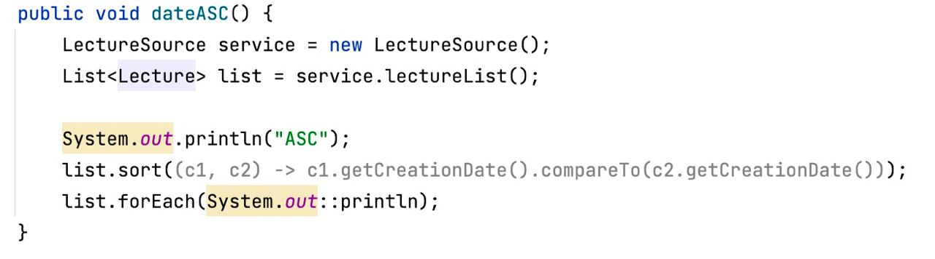
IDE is your friend

Slide 11
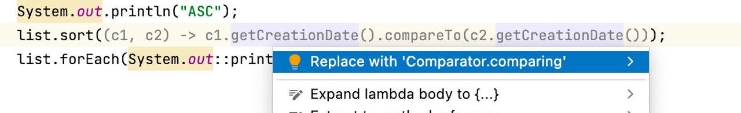
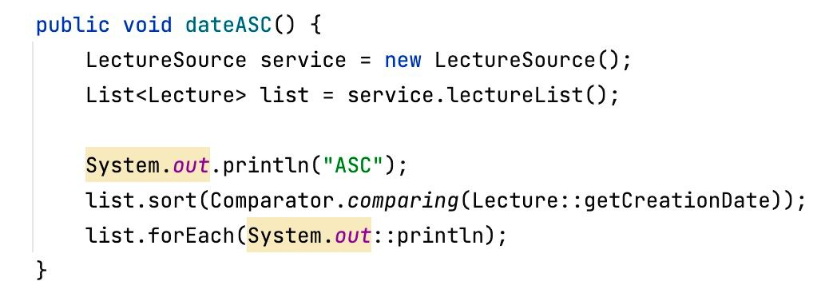
IDE is your friend

Slide 12
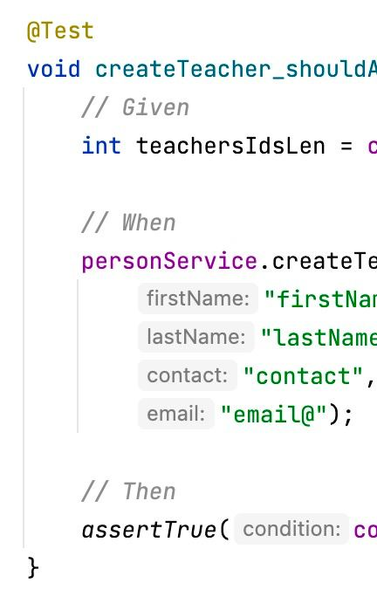
Remove unnecessary comments

Slide 13
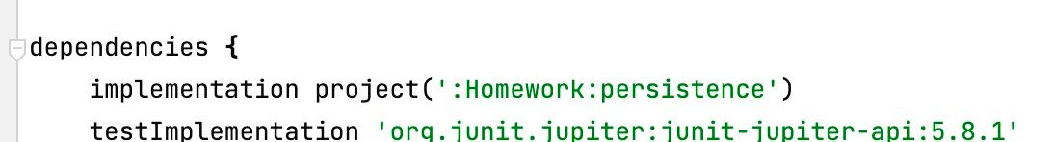
Follow layer structure

Slide 14
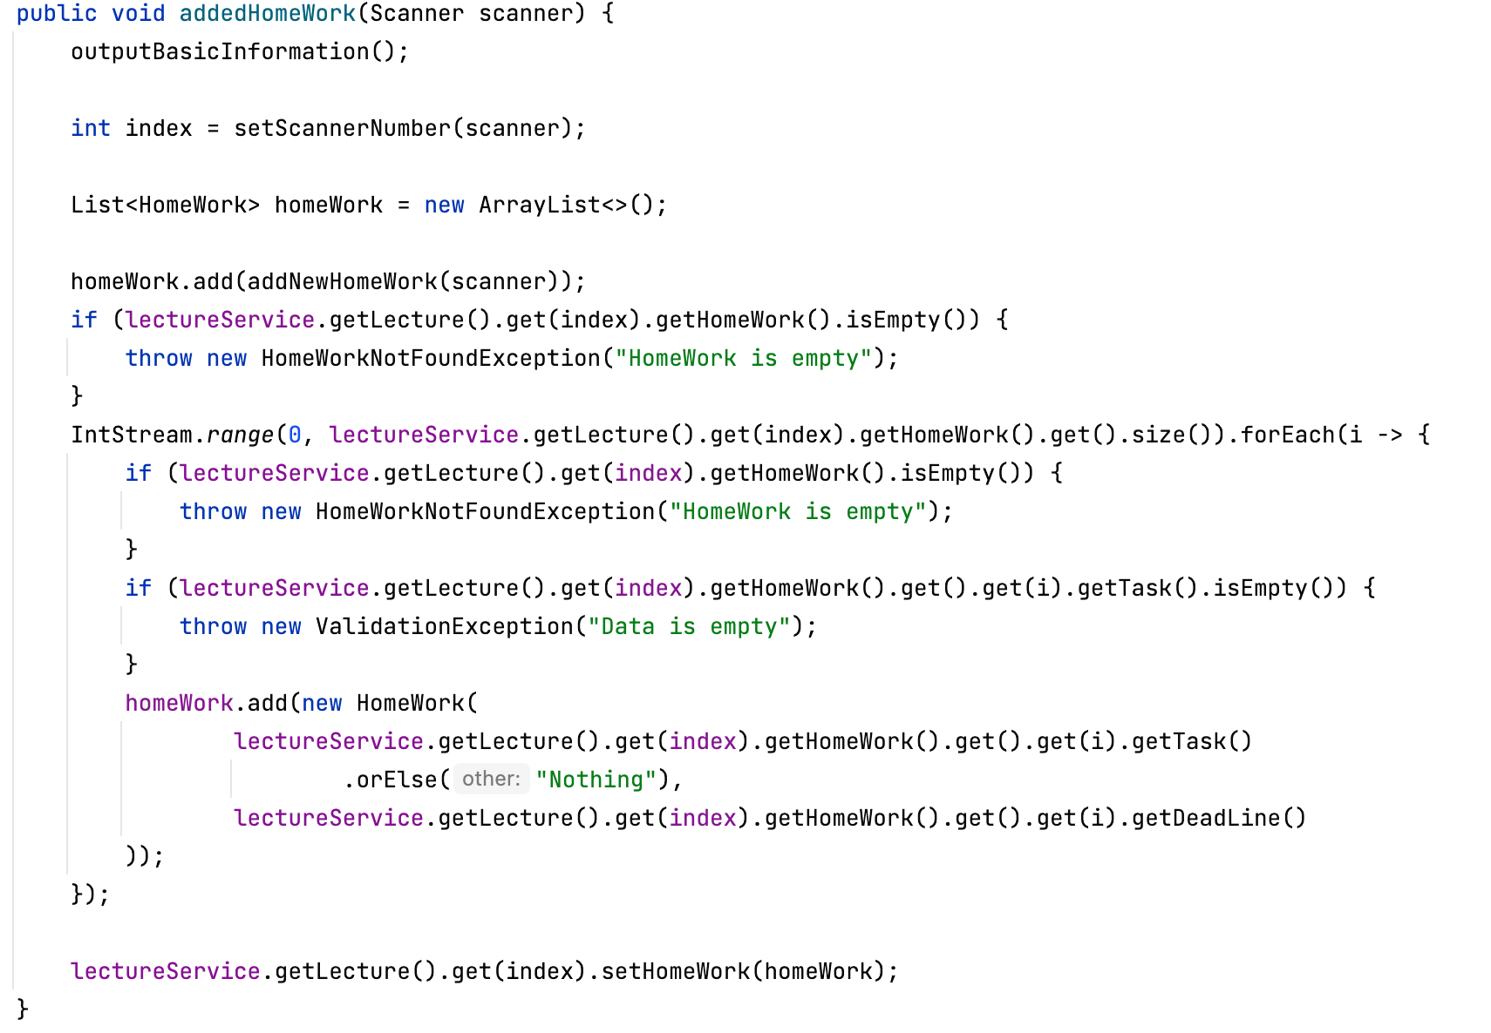
Simplicity is the key

Slide 15
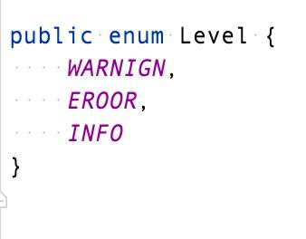
Follow naming conventions
LevelType
MessageStatus
RequestType

Slide 16
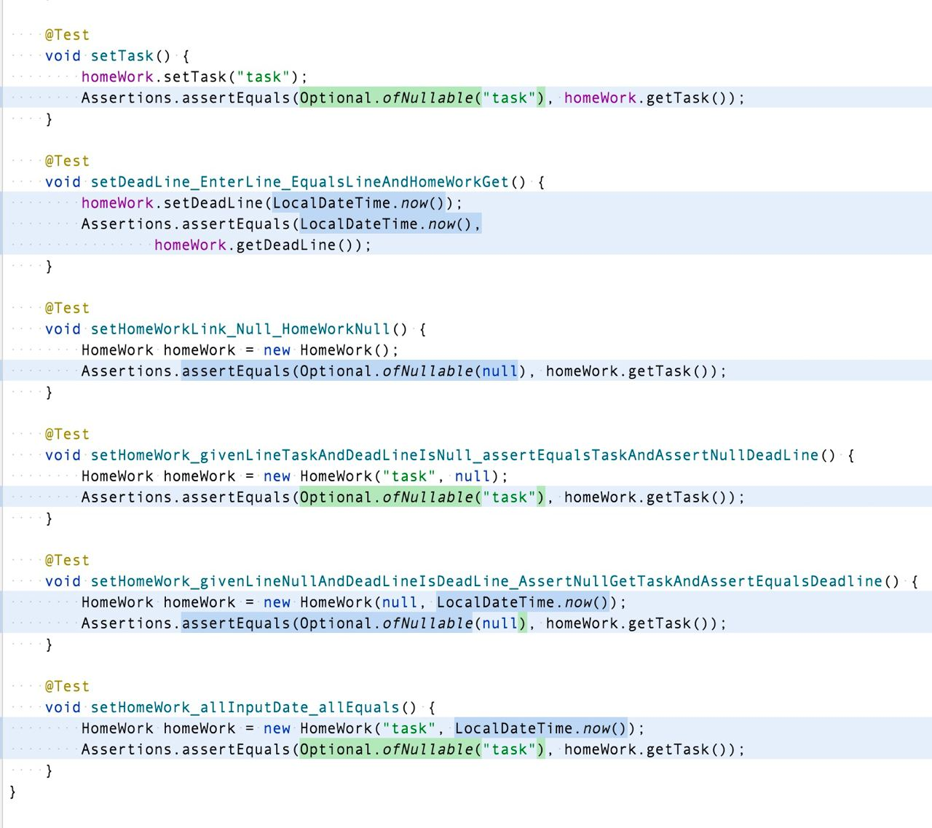
Write test for service, not for model.

Slide 17
Need more time?

Slide 18
Fix it!

